Slide 1
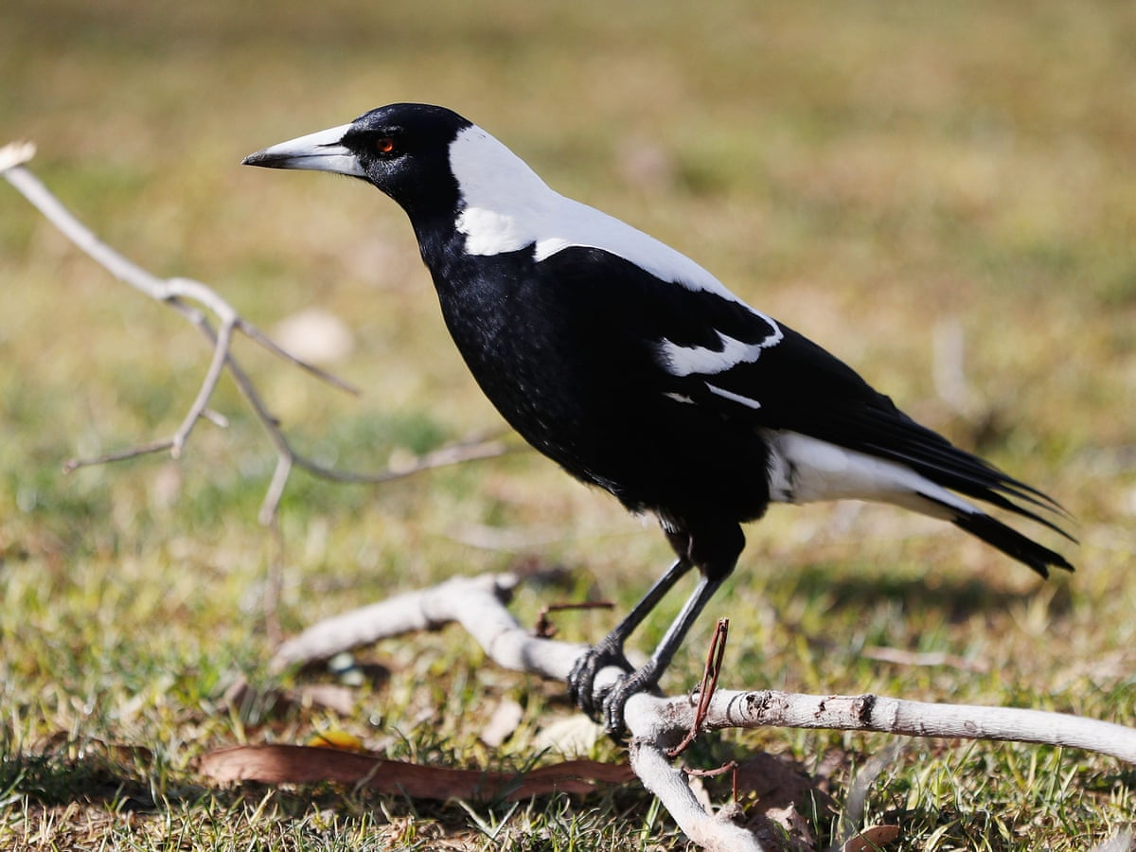



Pica Research
Dr Samuel Chawner
Wellcome Trust Career Development Award Fellow
HCRW Emerging Leader
Division of Psychological Medicine & Clinical Neurosciences
Cardiff University

Slide 2


Slide 3
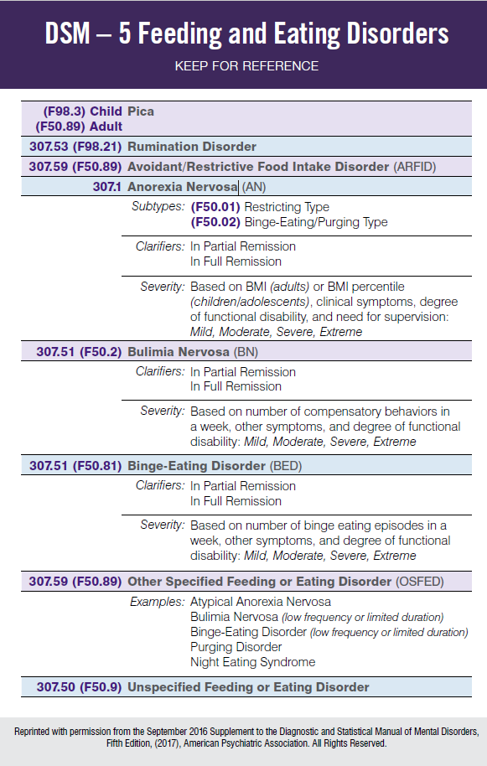
DSM 5 Eating Disorders
Pica
Rumination Disorder
ARFID
Anorexia Nervosa
Bulimia Nervosa
Binge-Eating Disorder

Slide 4
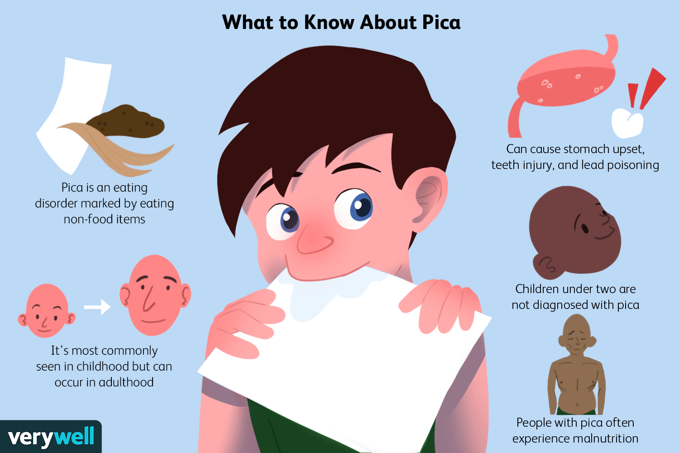

Slide 5
DSM 5 Pica criteria
A. Persistent eating of nonnutritive, nonfood substances over a period of at least 1 month.
B. The eating of nonnutritive, nonfood substances is inappropriate to the developmental level of the individual.
C. The eating behavior is not part of a culturally supported or socially normative practice.
D. If the eating behavior occurs in the context of another mental disorder (e.g., intellectual disability [intellectual developmental disorder], autism spectrum disorder, schizophrenia) or medical condition (including pregnancy), it is sufficiently severe to warrant additional clinical attention.

Slide 6
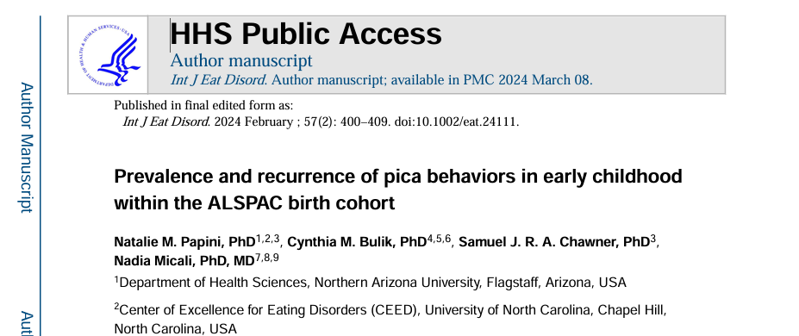

Slide 7



ALSPAC Avon Longitudinal Study of Parents and Children University of Bristol, UK 1990s-Ongoing
Research Focus
Investigating the effects of genetics and environment (G×E) on health and disease across the lifespan.
Sample Size
~14,000 families
Coverage
Southwest England
Data Collection Methods
In-depth interviews
Questionnaires
Medical records
Biological samples
Key Strength
Comprehensive genetic and environmental data enabling gene-environment interaction studies

Slide 8
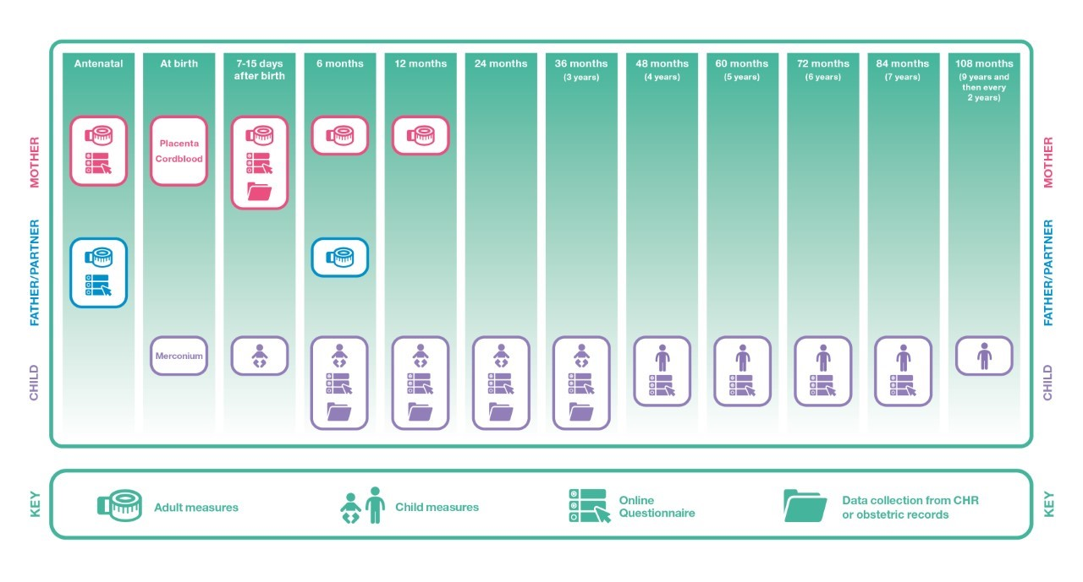

Slide 9
What did the study do?
Mothers were asked, “How often does the child eat coal, dirt, or other non-nutritious substances?”
3 years
4.5 years
5.5 years
6.5 years
9.5 years
Scored for “yes/no” for pica presence
When mothers answered “yes,” to the pica item, they were required to include what the child consumed

Slide 10
Pica Prevalence
3% at any age
3 years - 2.29%
4.5 years – 0.78%
5.5 years – 0.62%
6.5 years – 0.55%
9.5 years – 0.33%
20% persistent pica – 80% only at one age

Slide 11
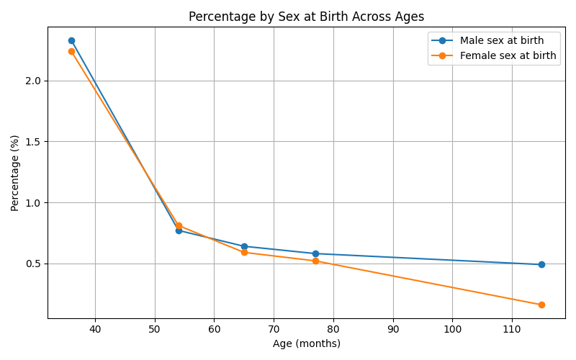
Male vs Female

Slide 12
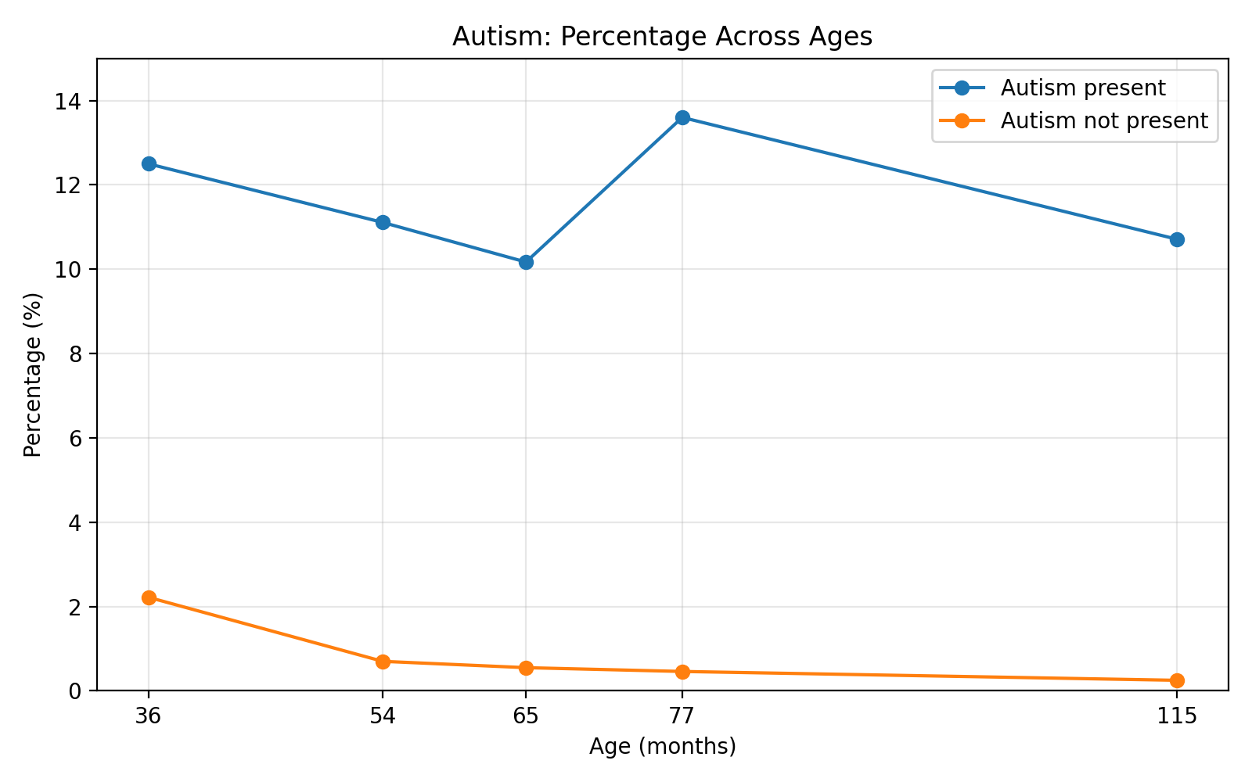
Neurodivergence: autism

Slide 13
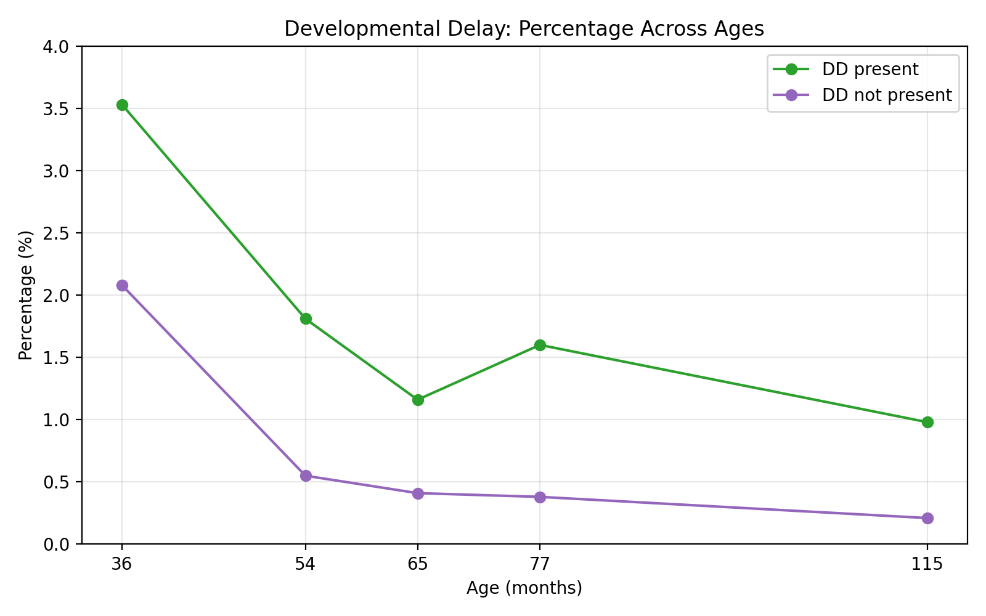
Neurodivergence: developmental delay

Slide 14
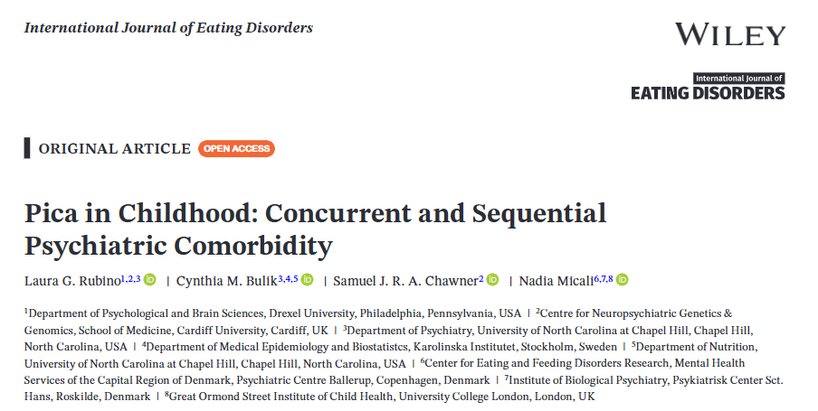

Slide 15
Psychiatric outcomes
Children with pica were more likely to have psychiatric or behavioural difficulties
Children with pica also showed more hyperactivity, conduct difficulties, peer problems, emotional challenges, and fewer prosocial behaviours.
No evidence was found that pica increased the chance of emotional disorders or later eating disorder risk.

Slide 16
Conclusions
Pica is common in childhood – 3%
Current NHS provision does not meet clinical need
Pica on average decreases with age – but many children persist
Associated with neurodivergence and psychiatric outcomes
Need for holistic clinical support

Slide 17
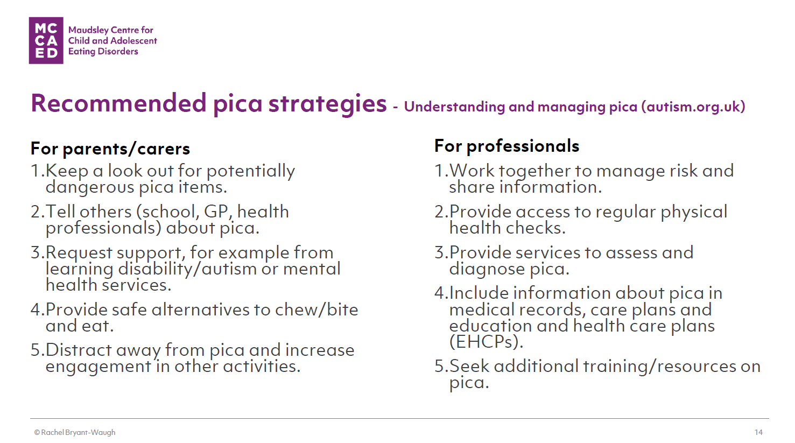


Slide 18
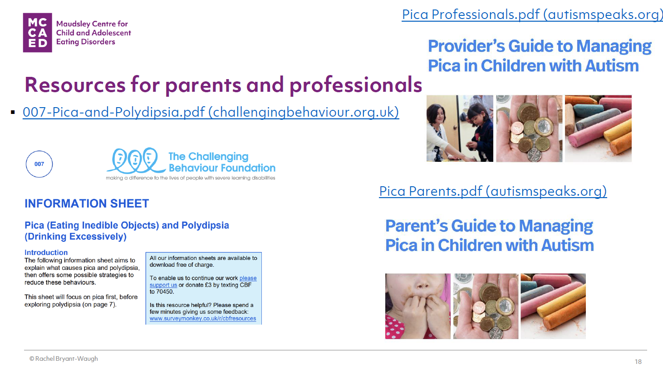

Slide 19






























Huge Thanks!

